Slide 1
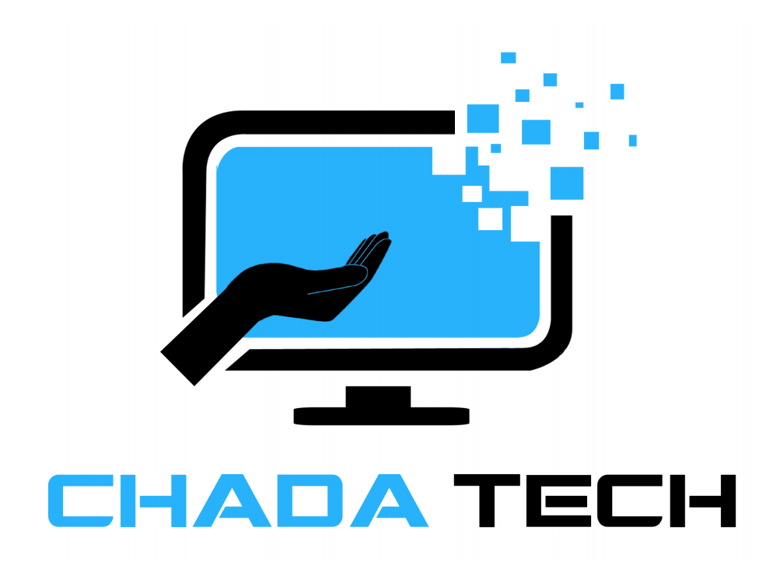
Scrum-Agile vs. Waterfall
Lessons from the SNHU Travel Pilot
Recommendation for Chada Tech leadership
Erik Caswell
CS 250 Software Development Lifecycle
Goal: To explain Scrum roles and Agile phases, compare Waterfall, and recommend the right approach for future Chada Tech projects.

Slide 2
1. Scrum Team Roles
Each role contributes a different perspective while the team works toward the same Sprint Goal.
Product Owner
Scrum Master
Prioritizes the Product Backlog, clarifies customer needs, and keeps the team focused on value. SNHU Travel: Turned focus group requests into prioritized user stories and acceptance criteria.
Supports effective Scrum practices, removes or helps resolve obstacles, and encourages team collaboration. SNHU Travel: Used team agreements and Scrum events to keep work visible and coordinated.
Developer
Tester
Builds and updates the working product and turns selected user stories into functional software. SNHU Travel: Modified the Java interface and implemented the Top Destinations feature.
Verifies that features meet the user story and acceptance criteria, identifies defects, and asks for clarification when requirements are unclear. SNHU Travel: Created test cases and clarified details such as destination ranking, display format, and expected behavior.
Why they matter together
Product Owner defines value → Developer builds → Tester verifies → Scrum Master supports the team. Frequent communication between the roles reduces misunderstandings and helps each increment meet the user's needs.
Source for Scrum accountabilities: Malmstadt (2024), Scrum.org. SNHU Travel examples are from course activities.

Slide 3
2. SDLC Phases in an Agile Approach
Agile still uses the SDLC phases, but cycles through them repeatedly in small increments.
1
2
3
4
5
6
Requirements
Design
Develop
Test
Release / Review
Maintain & Learn
User stories & backlog
Small, workable solution
Implement selected stories
Verify within the sprint
Inspect working increment
Feedback shapes next sprint
Focus group needs became user stories → The destination interface was designed and coded → Test cases verified the behavior → Product Owner feedback and changing business priorities shaped the next work.
SNHU Travel example
Sources: Microsoft (2022, 2025); Tozzi (2024).

Slide 4
3. How Waterfall Would Have Changed the Project
Waterfall moves through major phases sequentially, Agile expects inspection and adaptation throughout development.
Agile used in SNHU Travel
Waterfall alternative
Requirements were captured as user stories and refined as the team learned more.
Testing and clarification happened during the development cycle.
The Product Owner could reprioritize backlog items when business needs changed.
Working features could be reviewed before the entire product was complete.
Requirements would be documented and approved before later phases begin.
Major testing would occur after implementation, increasing the cost of late discoveries.
A mid project priority change would require formal rework across completed phases.
Stakeholders would see less working software until later in the lifecycle.
Course example: The project changed direction toward detox and wellness travel. Scrum allowed the Product Owner to reorder priorities and preserve useful work. In Waterfall, that change would have forced revisions to approved requirements, design, testing plans, and schedule.
Sources: Kirvan, Lutkevich, & Lewis (2024); Tozzi (2024).

Slide 5
4. Choosing Waterfall or Agile
The best methodology depends on the project.
Decision Factor
Waterfall is stronger when…
Agile is stronger when…
Requirements
Stable and unlikely to change
Evolving or discovered through feedback
Stakeholder feedback
Needed mainly at milestones
Needed frequently throughout development
Risk / uncertainty
Low, solution is well understood
Higher, experimentation and learning are expected
Documentation / approvals
Heavy formal documentation or stage gates
Lightweight documentation with working increments
Delivery strategy
One major release is acceptable
Incremental value is useful or necessary
Team environment
Specialized handoffs are manageable
Cross functional collaboration is available
Sources: Microsoft (2022); Kirvan, Lutkevich, & Lewis (2024); Tozzi (2024).

Slide 6
5. Recommendation for Chada Tech
Adopt Agile as the default for customer facing software projects, while selecting methods based on project conditions.
Scale carefully
Use transparent tools
Why Agile fits
SNHU Travel
Train teams on Scrum accountabilities and events. A new framework will not fix weak communication by itself.
Keep backlogs, priorities, owners, and blockers visible in a shared system such as Azure Boards or a similar Agile tool.
Customer preferences changed during development.
The team needed frequent clarification and feedback.
User stories allowed work to be prioritized and completed incrementally.
Testing and development could respond quickly to new information.
Keep Waterfall available
Measure outcomes
Predictive approaches can still fit projects with fixed requirements or low expected change.
Evaluate delivery speed, defect trends, stakeholder satisfaction, and the team’s ability to respond to change during rollout.
Bottom line: Chada Tech should move forward with Agile for projects like SNHU Travel because adaptability and feedback are central to success.
Sources: Malmstadt (2024); Microsoft (2026); Tozzi (2024).

Slide 7
References
Kirvan, P., Lutkevich, B., & Lewis, S. (November, 2024). What is a Waterfall model? Definition and guide. TechTarget. https://www.techtarget.com/it-infrastructure/definition/What-is-a-Waterfall-model-Definition-and-guide
Malmstadt, J. (May, 2024). How do Scrum roles drive team success? Scrum.org. https://www.scrum.org/resources/blog/how-do-scrum-roles-drive-team-success
Microsoft. (November, 2022). What is Agile development? Microsoft Learn. https://learn.microsoft.com/en-us/devops/plan/what-is-agile-development
Microsoft. (September, 2025). Microsoft Security Development Lifecycle (SDL). Microsoft Learn. https://learn.microsoft.com/en-us/compliance/assurance/assurance-microsoft-security-development-lifecycle
Microsoft. (June, 2026). Best practices for Agile product management. Microsoft Learn. https://learn.microsoft.com/en-us/azure/devops/boards/best-practices-agile-project-management
Tozzi, C. (May, 2024). Waterfall vs. Agile methodology: Differences and examples. TechTarget. https://www.techtarget.com/it-infrastructure/tip/Waterfall-vs-Agile-methodology-Differences-and-examples

